Slide 1
Marketing Your School Brand
Roche Center for Catholic Education
Boston College
Dr. Gerald smith
Carroll school of Management
Boston College

Slide 2
“Your School’s Brand?”
Our brand is: Where JESUS is the HEART of everything we do.
All decisions that are made for the school has our brand in mind. We remember always that we are a Catholic School with a Catholic Identity and we speak of faith-based values and morals in our school mission.
We brand our self using our school initials to incorporate our mission:
SNA: Spiritual Formation, Nourishment of Character, Academic Excellence, SNA.
We are a school that is rigorous, diverse and uses research-based curriculum.
Our brand has a reputation for a caring environment, capable, professional and dedicated faculty. A small school with the spirit of a big family with lots of heart.

Slide 3
“Stay Relevant?”
For families wanting a Catholic education, our school brand is extremely relevant and important. Some who want to come to our school simply cannot afford the monthly payment,
Our families are our greatest resource in getting the word out.
I think we do a fantastic job with this brand. All decisions are based on these three facets of our Mission Statement [Excellence--Spiritual, Academic and Social]. We are able to articulate and demonstrate examples to students and parents.
Currently investigating rebranding!
Since we are such a new school - we are constantly evaluating our brand and finding ways we can be better. It is part of a constant conversation. We have a weekly meetings as Administration and Directors and most always this is an agenda item. We stay relevant by listening to our parents, students, and stakeholders. People are definitely not shy about feedback and feel invested with us about our branding.

Slide 4
“Properly Positioned?”
As a pastor, I can say with conviction and enthusiasm, that our school is the best means that we have to refashion a church and a way of life that for many reasons - most acutely the dire shortage of priests - which is not experienced in parishes today. The Catholic School can be church today for so many of our families who would not otherwise have at the parish level what my brothers and I were blessed to . . .
We are in some advertisements in local papers. We advertise in Church bulletins and I try to keep the school active in the parish. We work closely with our public school district when it comes to title monies. I would like to learn some new marketing ideas.
We need work on this. Being a new school, St. Michael's is still unknown to many.
"the Catholic school"
WE ARE WORKING ON THIS ONE!
need to figure out how to get Pastors on board from area churches

Slide 5
“Brand Support?”
Having a person dedicated to being the Director of Marketing/Communications is incredible support to the school's brand. We have also an intern to work on communications. Administration is managing this piece of school life with the awareness of just how important it is to our success.
A marketing committee has been created as a subcommittee of our advisory board to manage and promote our brand.
These seem like difficult questions, and I'm not exactly sure what they mean. I believe we are focused on our brand, and yet I am keenly aware of the fact that our brand/vision needs better clarity/focus and that we have to make a concerted effort to advance this brand/vision with greater intensity, whether it be through social media or through inviting our stakeholders to take greater ownership of it.
Currently not as much support as it should have. Admissions position is going to be reworked over the coming month to meet the needs of the school and a marketing plan.

Slide 6
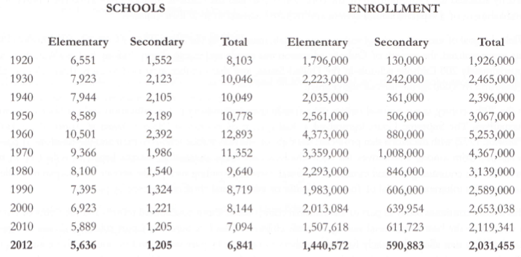
Catholic School Trends
-47%
-61%

Slide 7
Catholic Schools Differentiation

Slide 8
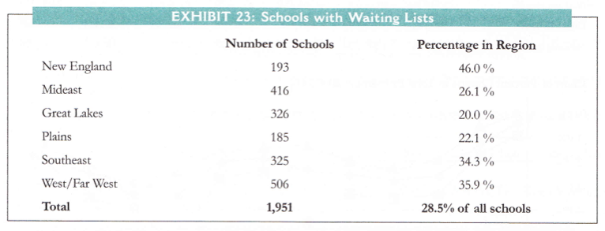
Strong Demand for Catholic Schools

Slide 9
Sustainable Business Model?

Slide 10
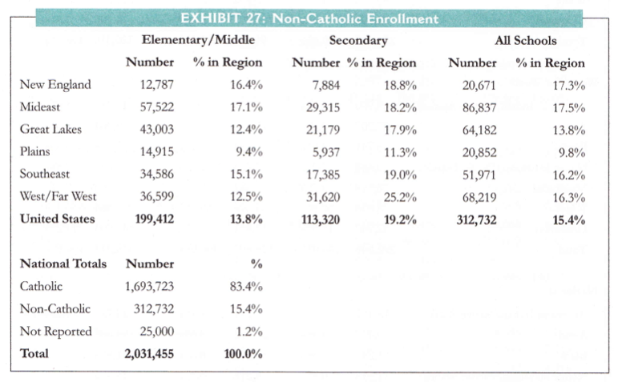
Non-Catholics as a Target Market
1970: 2.7%

Slide 11
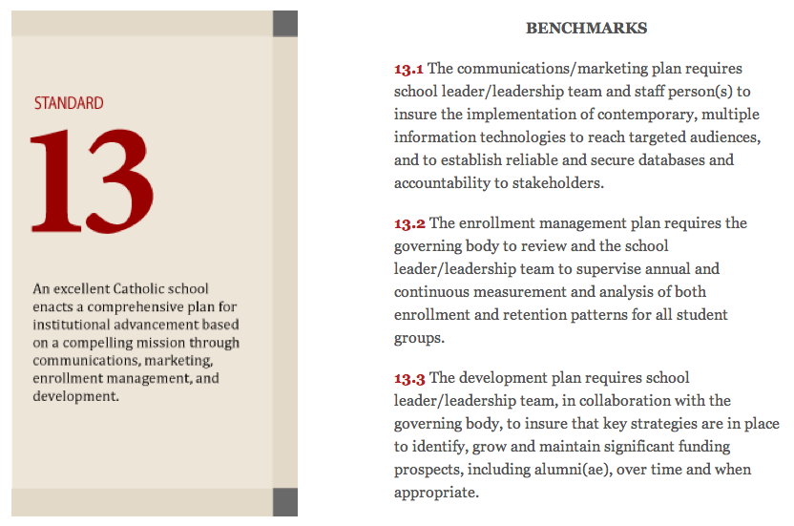

Slide 12
Which is Worth More?
Apple Intangible Brand Assets
Apple Names and Logo
Apple Trademarks
Apple Tangible Assets
Other Assets
$63 Billion
Property, Plant & Equipment
$8 Billion
Current Assets
$45 Billion
Apple Patents
Apple Design and Engineering
Total
Brand Assets
Value
$ __________
Total
Book
Value
$116 Billion
Apple’s Total Market Value (March 2012)
$506.2 Billion

Slide 13
Brand Associations, Brand Image

Slide 14
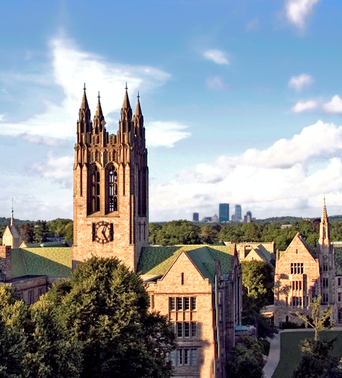

Slide 15
What is a Brand?
Brand is the identity of [your school] – represented in name, symbol, design and/or experience – that links key benefits with perceived values, image and personality, and differentiates from those of the competition.
Adapted from American Marketing Association definition. See Journal of Marketing Management, 1998, 14, 417-443.

Slide 16
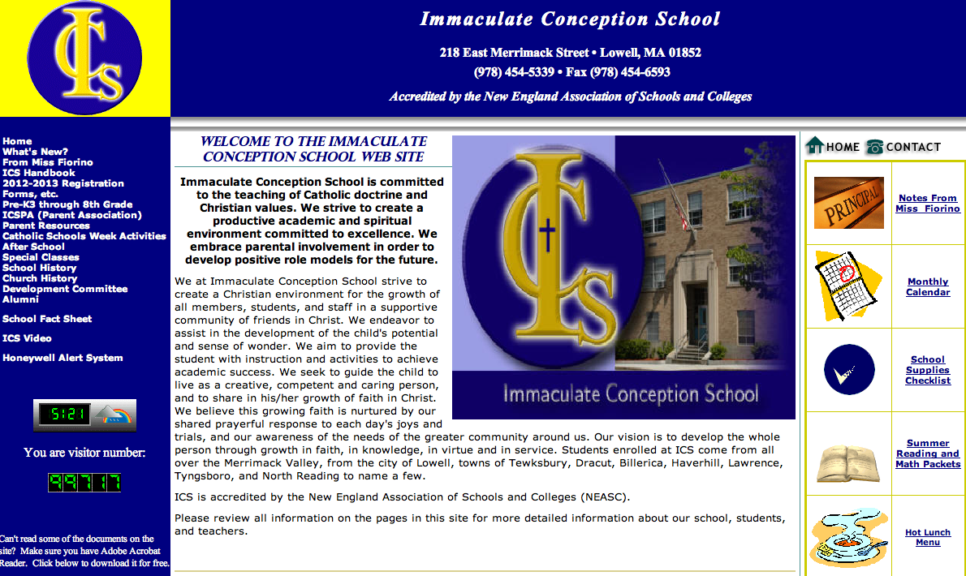
What does this Brand Communicate?

Slide 17
The Worth of a Brand
Brand’s
Differentiation
Brand
Frame of Reference

Slide 18
Catholic Competitive Brand Frames of Reference High Schools
Private
Schools (Day)
$27-39,000
Milton Acad $39,000
Gov Dummer $38,415
Phillips Andover $34,500
Worcester Acad $26,610
Catholic Independent Private Schools
$ 10-37,000
Newton CDS
Notre Dame
BC High
Catholic Memorial
St Joseph Prep
Catholic Diocesan Schools
$ 5-10,000
Catholic Parish Schools
$ 6-9,000
St Dominic Academy
Holyoke Catholic
Holy Name
Cathedral High School
St Clement Jr/Sr
Arlington Catholic
St Mary’s Lynn

Slide 19
Other Frames of Reference
Parish Academy
Parish Institute (STEM)
Parish Arts Academy
Parish STEAM School
Parish Vocational School
Parish Special Needs School
Parish Montessori School
Parish Bi-Lingual School
Parish ___________ School

Slide 20
Customer Perceptions of the Worth of St. Agatha’s School
$18,000
Differentiation
< 22 Students/Class
Strong Principles
Strong Team
Academics + Faith
Rigorous
Nice Facilities
$13,200
Average Tuition: $5,100
$4,800
Personally Selected Schools in the Region
(evoked)
St Jerome $4,800
Our Lady of the Lake $4,700
St Paul $3,600
East Charter School Free

Slide 21
Value Proposition
Target Market
Frame of Reference
Point of Difference
Reason to Believe

Slide 22
Boston College Value Proposition
Target Market
Frame of Reference
Point of Difference
Reason to Believe
Because it is grounded in the Jesuit, Catholic tradition uniting academic achievement and service to others.
For high achieving students with very strong academic qualifications
Boston College is one of the nation's best and most selective universities
Dedicated to holistic student formation based on intellectual, personal, ethical, and religious life

Slide 23
_____________ School Value Proposition
Target Market
Frame of Reference
Point of Difference
Reason to Believe

